Slide 1


Presentation on
Online Journal Management System
Prepared By
Md. Sabbir Talukdar
ID# 16103128
Program: BCSE
Supervised By
Md Sakibul Islam
Lecturer
Department Of Computer Science and Engineering
October 7, 2020

Slide 2
Contents
Organization Overview
Introduction
Objectives
Software Process Model
Requirement Engineering
Use Case Diagram
Function Point
Cost Estimation
Activity Diagram
Entity Relationship Diagram
Data Flow Diagram
Testing
Project Demonstration
Conclusion
October 7, 2020
2

Slide 3
Organizational Overview
Developing Organization of Rural Poor (DORP), is an NGO company in Bangladesh. We have 4 years of experience in web design and development.
Our services consist of
Livelihood, Mirco-Finance and Resettlement
Software Development
Health, Nutrition, Education and WASH
Environment and Climate change
October 7, 2020
3

Slide 4
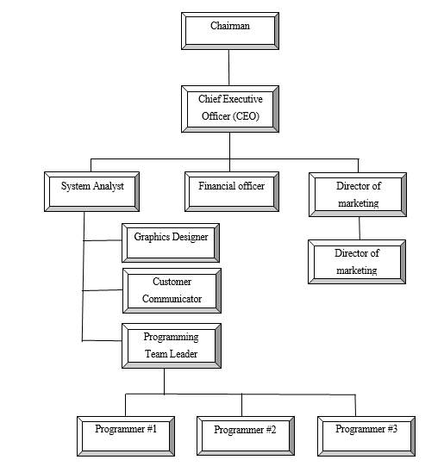
Organizational Structure
October 7, 2020
4

Slide 5
Introduction
This project can be used as a journal management system online.
It can upload papers, feedback systems from judges, re-upload based on changes and final publishing.
It maintains admin, authors and judges information.
It is web based application.
October 7, 2020
5

Slide 6
General Objective
The general objective of this project is to use my institutional educational experience in the real life working environment by developing Online Journal Management System for Development Organization of Rural Poor .
October 7, 2020
6

Slide 7
Specific Objectives
View Paper Information
Upload Papers
Get feedback from judges
Re uploading the papers
Provide feedbacks on papers
View paper pdf
Add, Update, Judge Details
Manage paper categories
Search contents based on the given information
October 7, 2020
7

Slide 8
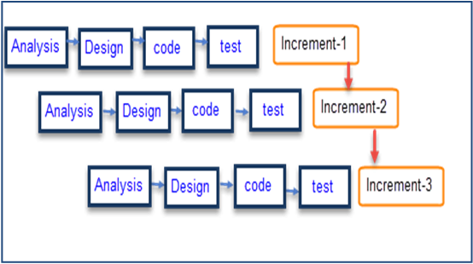
Software Process Model
Figure: Incremental Process Model
October 7, 2020
8

Slide 9
Why I Have Chosen This Model ?
In this model user can respond to each built.
It is flexible and less expensive to change requirements and scope.
Errors are easy to be identified.
Generates working software quickly and early during the software life cycle
October 7, 2020
9

Slide 10
Feasibility Study
Technical Feasibility
Economic Feasibility
Operational Feasibility
October 7, 2020
10

Slide 11
Requirement Engineering
User Requirements
System Requirements
Functional Requirements
Non-functional Requirements
October 7, 2020
11

Slide 12
User & System Requirements
Admin can create judges
Admin can view judge information
Admin can update judge information
Admin can delete individual judge information
Admin can search individual judge
Admin can view the authors details
Admin can add paper categories
Admin can view feedback from judges
Admin can publish papers based on feedback
Admin can assign judges to paper categories
October 7, 2020
12

Slide 13
User & System Requirements Continue…
Judges can view paper pdf
Judges can view paper information
Judges can give feedback after paper review
Judges can receive papers based on the category they are assigned to.
Judges can download the papers
Authors can upload paper
Authors can choose paper category
Author can add Co-Authors
Author will be notified when the paper is published
Author can see the judge feedbacks
Author can manage paper informations
October 7, 2020
13

Slide 14
Functional Requirements
Admin can maintain whole system.
Admin can add, view, search, update, & delete Paper Categories
Admin can add, view, search, update and delete Judge information
Admin can publish papers based on the feedbacks from judges
Admin can assign paper Categories to Judges
Judges can receive papers based on the category assigned to them
Judges can search papers based on any information
Judges can give feedbacks after viewing the paper
Judges can approve the papers
Authors can receive message after the judges have reviewed
Authors can receive messages after the admin has published the paper
October 7, 2020
14

Slide 15
Functional Requirements Continued
Author can upload paper.
Author can add co-authors
Author can view the feedbacks
Admin can search based on any informations
October 7, 2020
14

Slide 16
Non Functional Requirements
Admin can log in by using email and password.
Author can log in by using email and password.
Judge can log in by using email and password.
This system support only Windows 7/8/10
October 7, 2020
15

Slide 17
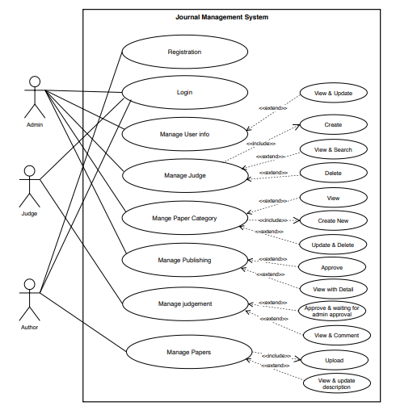
Use Case Diagram
October 7, 2020
16

Slide 18
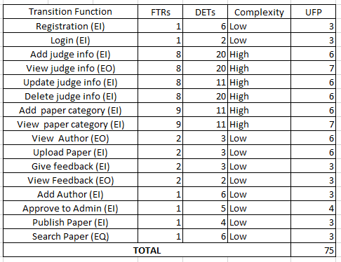
Identifying Complexity For Transaction Function
October 7, 2020
17

Slide 19
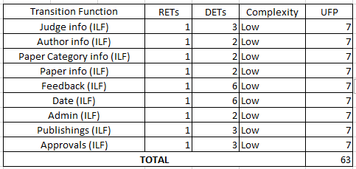
Identifying Complexity For Data Function
October 7, 2020
18

Slide 20
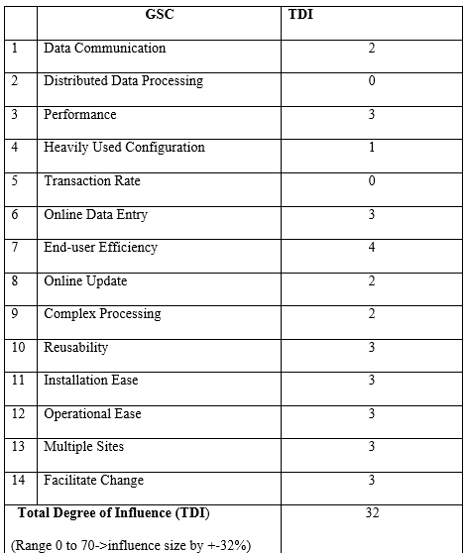
Performance & Environmental Impact
October 7, 2020
19

Slide 21
Final Calculation
Value adjustment factor (VAF) = (0.65+ (0.01* TDI))
= (0.65+ (0.01* 32))
= 0.97
UFP= UFP (Data function) + UFP (Transaction function)
= 88 + 84 = 172
AFP= UFP * VAF = 172 * 0.97 = 167 Approx.
Total time calculation frame = 167 * 15.5 [Productivity of PHP is 15.5] = 2588.5 per hour
= 2589 person hours / 7.5 hours
= 345 person days / 3 [person in a group]
= 115 days
= 3 months 25 days for three persons
Approximately 4 months required for three persons to finish the project.
October 7, 2020
20

Slide 22
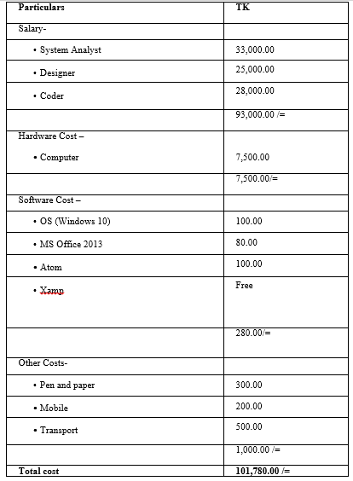
Cost Estimation
October 7, 2020
21

Slide 23
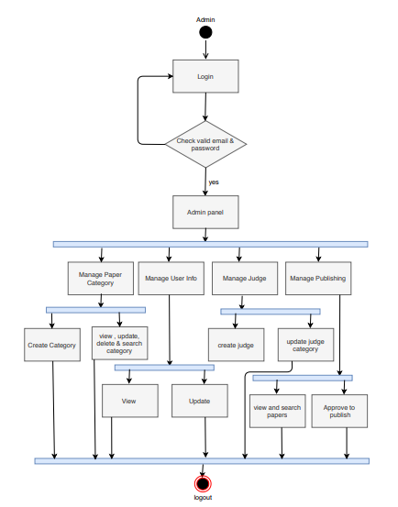
Activity Diagram For Admin
October 7, 2020
22

Slide 24
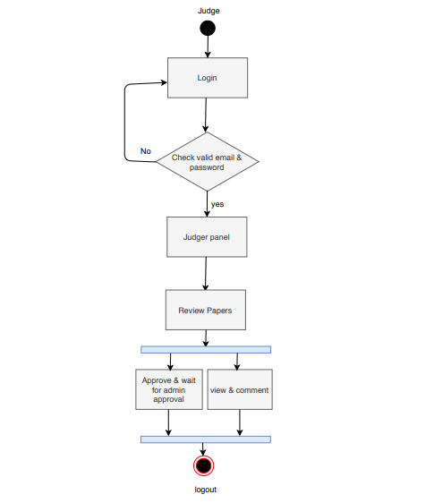
Activity Diagram For Judge
October 7, 2020
23

Slide 25
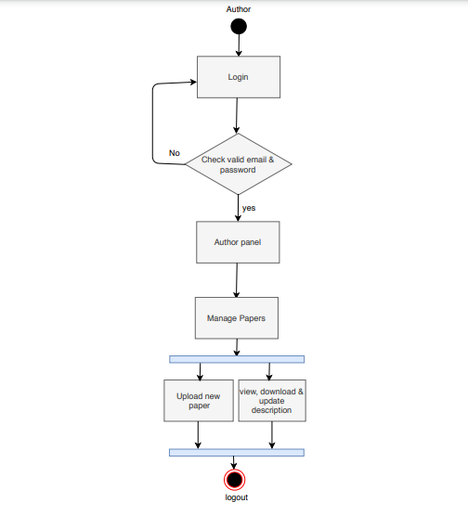
Activity Diagram For Author
October 7, 2020
23

Slide 26
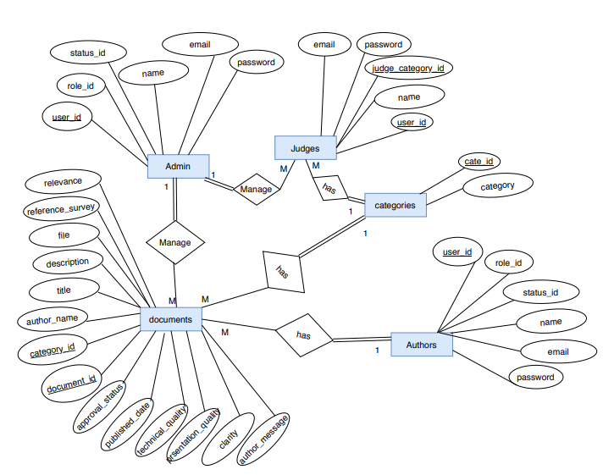
Entity Relationship Diagram
October 7, 2020
24

Slide 27
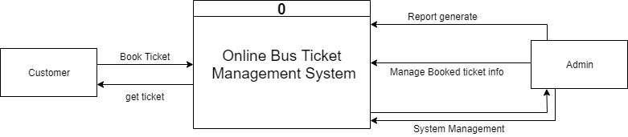
Context Level DFD
Judge
View Paper
Give Feedback
Publish Paper
Upload Paper
Online Journal Management System
Author
Manage paper info
Get feedback
October 7, 2020
25

Slide 28
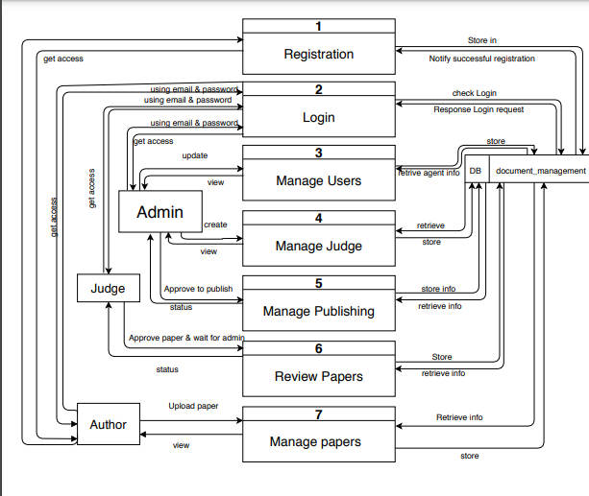
Level-1 DFD
October 7, 2020
26

Slide 29
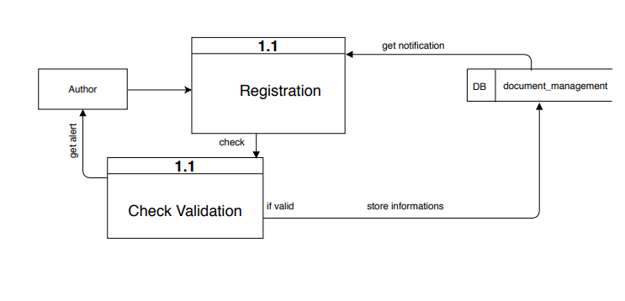
Level 2- Process 1 DFD
2
October 7, 2020
27

Slide 30
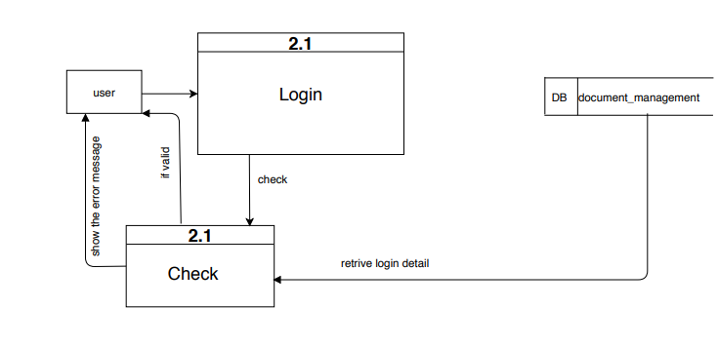
2
Level 2- Process 2 DFD
2
October 7, 2020
28

Slide 31
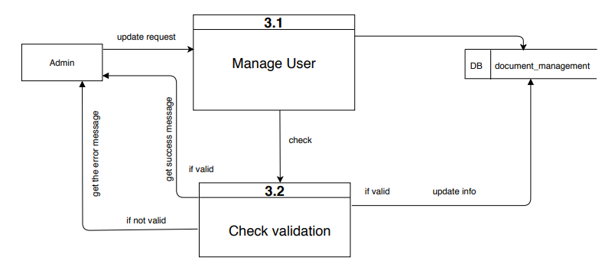
Level 2- Process 3 DFD
October 7, 2020
29

Slide 32
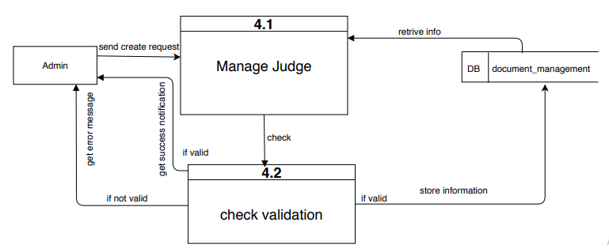
Level 2- Process 4 DFD
October 7, 2020
30

Slide 33
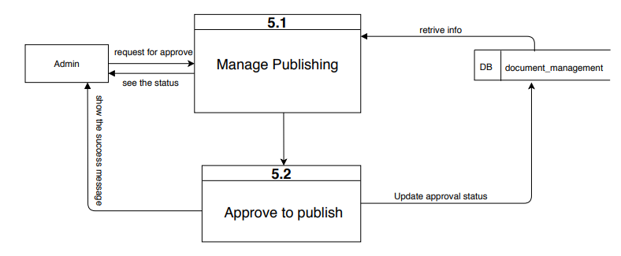
Level 2- Process 5 DFD
October 7, 2020
31

Slide 34
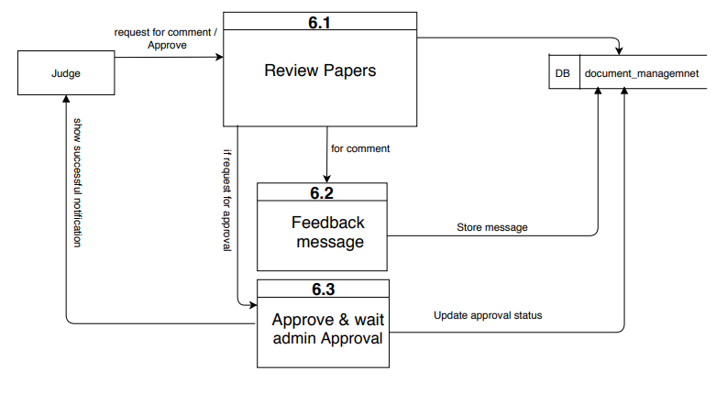
Level 2- Process 6 DFD
October 7, 2020
32

Slide 35
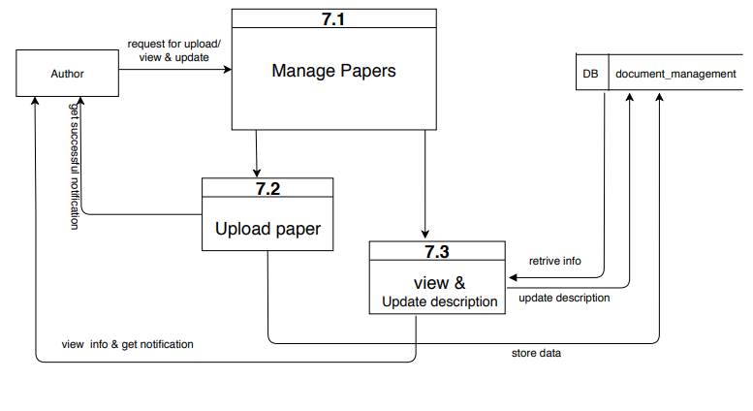
Level 2- Process 7 DFD
October 7, 2020
33

Slide 36
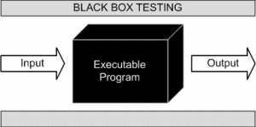
System Testing Methodology
Figure: Black Box Testing
October 7, 2020
36

Slide 37
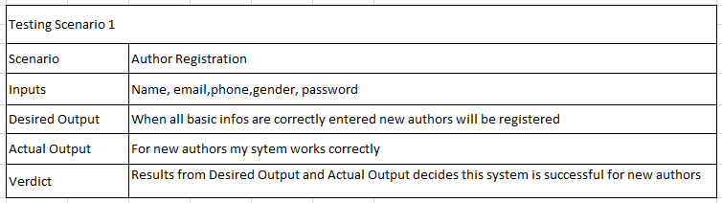
Testing Scenario
October 7, 2020
37

Slide 38

Let’s Visit The Website

Slide 39
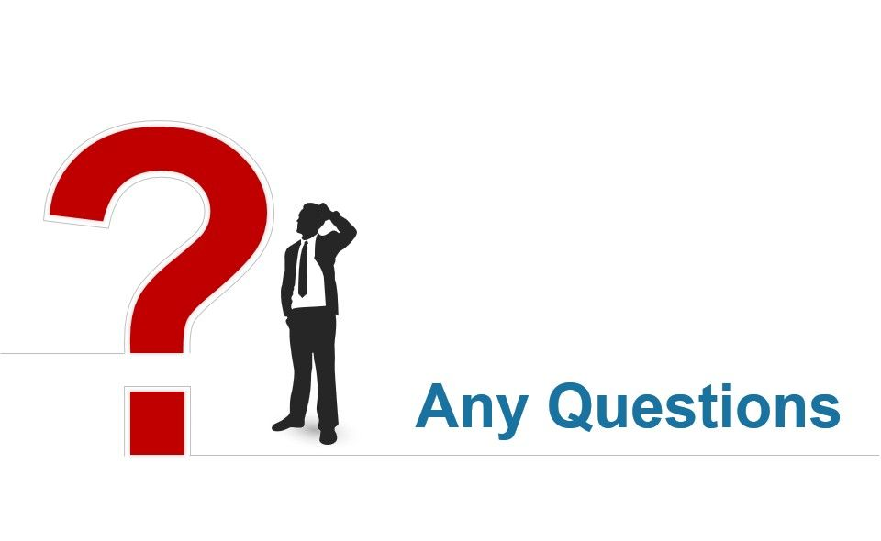
October 7, 2020
39

Slide 40

October 7, 2020
40

Slide 41
Thank You

